Slide 1
Employee Data Analysis using Excel
STUDENT NAME : Nivetha S.R
REGISTER NO : 312209215
DEPARTMENT : B.Com Bank Management
COLLEGE : Anna Adarsh College For Women

Slide 2
PROJECT TITLE
Employee Performance Analysis using Excel

Slide 3


AGENDA
Problem Statement
Project Overview
End Users
Our Solution and Proposition
Dataset Description
Modelling Approach
Results and Discussion
Conclusion
3/21/2024 Annual Review

Slide 4

PROBLEM STATEMENT
1.Trend Analysis: Observing how employee ratings change over time or in response to certain factors can provide insights into the effectiveness of changes or interventions implemented in the workplace.
2.Diversity and Inclusion: Understanding gender distribution and its impact on ratings helps in evaluating the effectiveness of diversity and inclusion initiatives. This can guide efforts to promote a more equitable work environment.

Slide 5

PROJECT OVERVIEW
Objective
The primary objective of this project is to analyze employment data to uncover insights related to employee ratings based on gender and various row labels (e.g., departments, job roles). This analysis aims to identify patterns, disparities, and trends that can inform decision-making to enhance organizational performance and promote a fair work environment.
.

Slide 6
Scope
Data Collection: The dataset includes employee ratings, gender, and row labels representing different categories such as departments, job roles, or locations.
Analysis Focus : Assess gender-based disparities in employee ratings.
Evaluate employee performance across different row labels.
Identify trends and patterns in ratings over time or between categories.
Explore potential correlations between gender and performance ratings.

Slide 7

WHO ARE THE END USERS?
Human Resources (HR) Teams: HR professionals use performance analysis to make informed decisions about promotions, raises, training needs, and to address potential issues related to employee satisfaction and engagement.
Managers and Team Leaders: Managers use performance data to assess team performance, identify high performers and those needing support, and make decisions related to team composition and development.
Executive Leadership: Senior leaders and executives use the data to understand overall organizational performance, assess the effectiveness of strategic initiatives, and guide decision-making for organizational growth and culture

Slide 8

OUR SOLUTION AND ITS VALUE PROPOSITION
Filtering - refine raw data
Charts - visualisation
Pivot table - Summary

Slide 9
Dataset Description
Employee dataset - kaggle
5 features
Business unit
Department type
Gender code
Performance score
Current employee rating

Slide 10
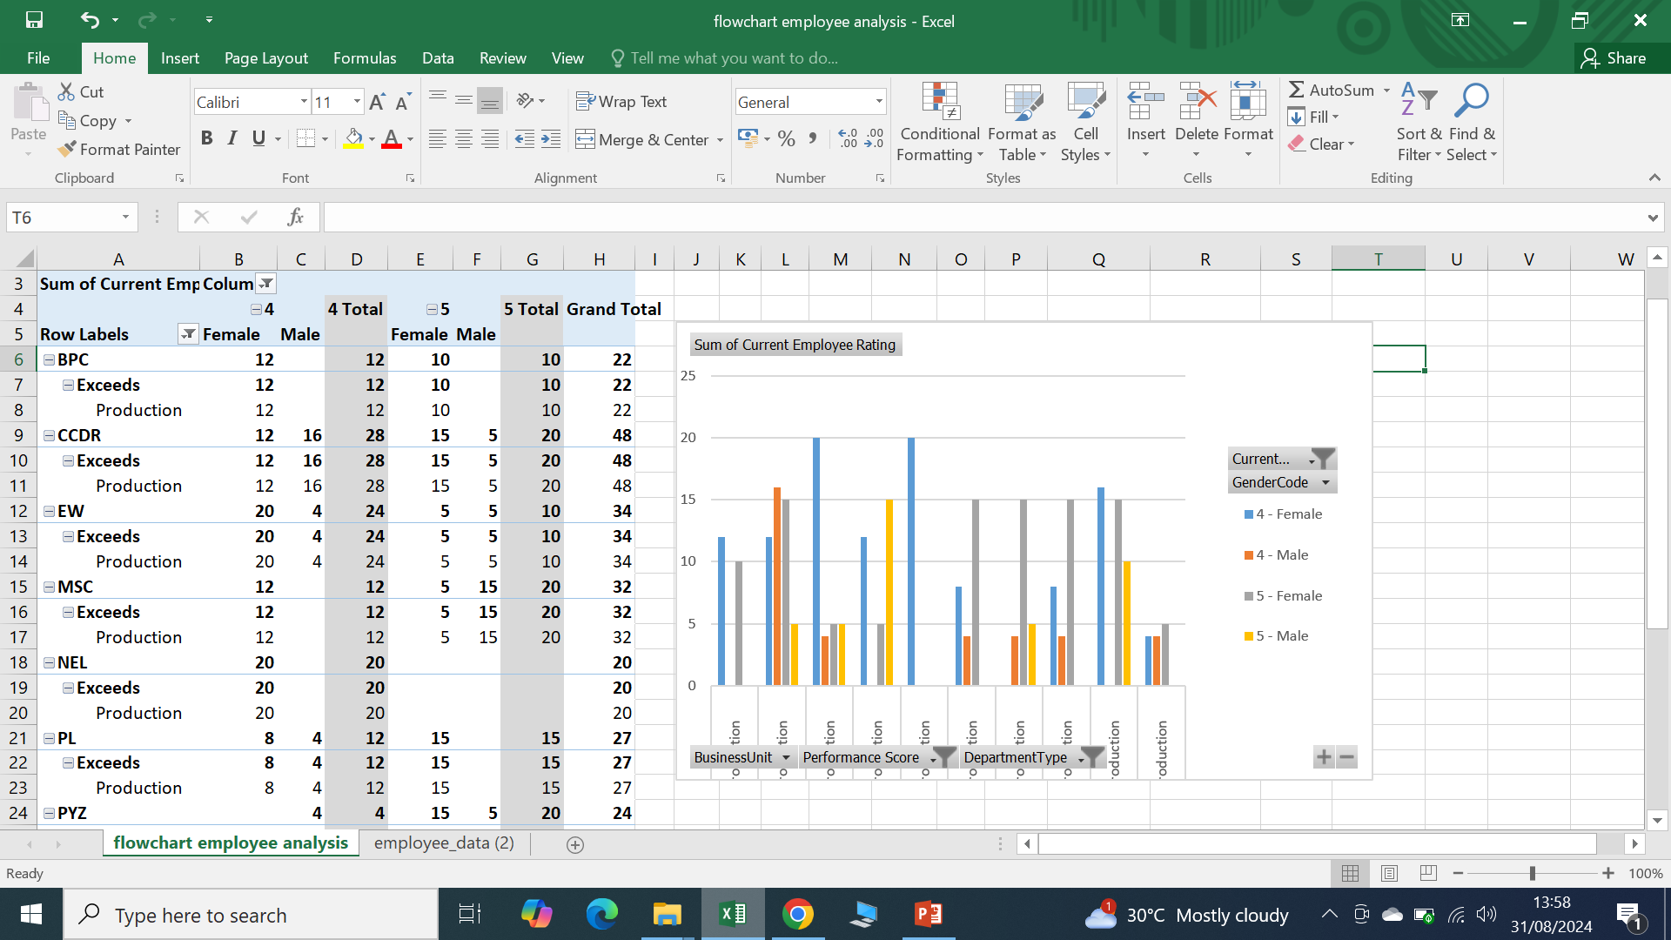
RESULTS
10

Slide 11
conclusion
Employee performance analysis is a powerful tool for making informed decisions about overall performance trend, identify strength and weakness employee capabilities. Based on the analysis, suggest areas where additional training or professional development could enhance performance.

